Slide 1

Next-Gen Spam & Smishing Detection
An AI-powered pipeline to combat modern messaging threats using merged datasets and Natural Language Processing.

Slide 2

The Problem
Traditional spam filters fail against modern "Smishing" (SMS Phishing) attacks—such as fake UPI alerts, OTP frauds, and malicious delivery links. A model trained on legacy data cannot protect today's users.

Slide 3

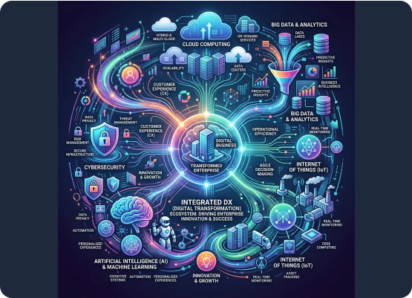
The Solution: Dataset Aggregation
Legacy Data: Utilized the classic UCI SMS Spam dataset for baseline non-spam (Ham) and standard spam recognition.
Modern Threat Integration: Downloaded and integrated a recent Kaggle "Smishing" dataset containing modern OTP and UPI frauds.
Standardization: Addressed critical case-sensitivity issues (e.g., converting 'Smishing' and 'Spam' to a uniform 'spam' target).
Seamless Merge: Combined datasets using Pandas `concat` with `ignore_index=True` to create a massive, robust training ground.

Slide 4

Unprecedented Training Volume
Data Scale & Integrity
11.5k
After merging the legacy and modern datasets, we rigorously dropped missing values (nulls) and strictly removed duplicate entries (`drop_duplicates`).
This process yielded a pristine, highly diversified dataset of over 11,500 unique messages, ensuring the AI model learns complex patterns without overfitting to repeated data.
TOTAL MESSAGES

Slide 5









NLP Preprocessing Pipeline
1. Text Cleaning
2. Tokenization
3. Refinement
Lowercasing all text to ensure uniformity. Stripping out irrelevant numerical columns, URLs, and specialized tags that confuse the vectorizer.
Leveraging NLTK (`word_tokenize` and `sent_tokenize`) inside efficient lambda functions to break down massive text blocks into granular, analyzable words.
Removing linguistic noise by filtering out standard English stopwords and punctuation, followed by Porter Stemming to extract root word meanings.

Slide 6

Feature Engineering
Structural Features
TF-IDF Vectorization
We extracted meta-features before altering the text. By applying Pandas `.apply(len)` and NLTK logic, we created num_char, num_words, and num_sent.
Machines cannot understand text. We deployed Term Frequency-Inverse Document Frequency (TF-IDF) to convert textual data into a numerical matrix.
Spam messages mathematically display higher structural complexity and character density compared to normal ham messages.
This algorithm penalizes highly frequent, meaningless words while boosting rare, high-impact terms like "OTP", "Urgent", or "Winner".

Slide 7
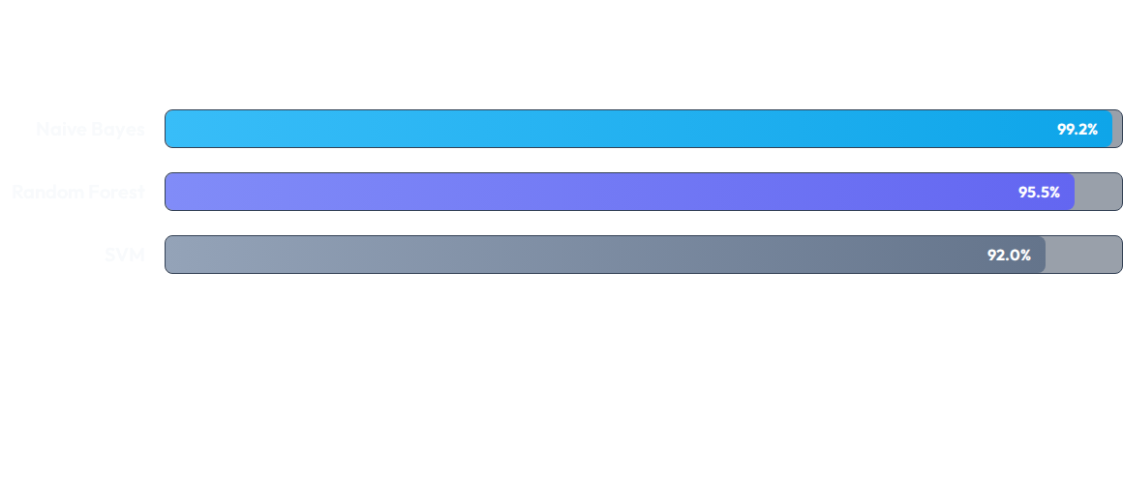
Model Evaluation (Precision Focus)
In spam detection, Precision is the critical metric. A false positive (marking a real message as spam) is disastrous. Naive Bayes outperformed complex ensemble models, yielding near-perfect precision on the merged dataset.

Slide 8
Project Development Workflow
Phase 2
Phase 4
Data cleaning, fixing case sensitivity, and dropping duplicates/nulls.
Model Training, Pickling (.pkl), and deploying via Streamlit UI.
Phase 1
Phase 3
Dataset acquisition, merging Legacy (UCI) and Modern (Smishing) data.
Exploratory Data Analysis (EDA) & NLP Feature Engineering.

Slide 9

Real-world Impact
Protecting the Digital Economy
By upgrading the core training data, our model has shifted from merely detecting annoying marketing texts to actively blocking malicious financial threats.
This AI infrastructure provides real-time defense against identity theft, deceptive banking links, and localized cyber-attacks, proving the necessity of continuous data adaptation.

Slide 10

Questions?
Thank you for your time and attention.

